Slide 1



Uncovering the shapes of comets from the ground: The nucleus of comet 162P/Siding-Spring
Abbie Donaldson¹ Colin Snodgrass¹ Rosita Kokotanekova² Agata Rożek¹
Introduction
To date, information on the shapes of comet nuclei has been obtained primarily from a small number of situ missions and radar observations.
70% of seven short period comet nuclei show a bilobed morphology (described as ‘contact binaries’).
It is estimated that 20% of ~1000 radar-detected near-Earth asteroids (NEAs) could be contact binaries.
Is there a process specific to comets that results in the preferential formation of bilobed shapes? The sample size of comet nuclei with well-constrained shapes is currently too small to draw any conclusions.
Aims of this work:
Use lightcurves of Jupiter-family comet (JFC) 162P/Siding-Spring to create a convex model of its nucleus.
Explore to what extent convex lightcurve inversion can be used to expand the number of comets with well-constrained shape information.
162P/Siding-Spring
Large (R_{eff} ~ 7km), inactive JFC, rotation period 32.8h.
R-band lightcurves between 2007 and 2018 provide good coverage of the rotational variation of the nucleus (Fig.1).
Geometric albedo 2.2% - one of the darkest surfaces of all studied comets [1].
Figure 1: Combined lightcurves for 162P. H_{r} calculated with linear phase function slope β=0.049.
Results
Model param | Best fit value
λ, β | 300°, 38°
ε | 24°
a/b | 1.55
P_{sid} | 32.85 h
Figure 2: Top row: convex model of 67P/Churyumov-Gerasimenko, the only other comet to have been modelled by convex inversion to date [2]. Bottom row: reconstruction of 67P’s actual nucleus shape from spacecraft images [3].
Convex lightcurve inversion procedure
The shape of a small body has a larger effect on its rotational lightcurve than variations in light scattering properties across its surface [4,5], meaning we can extract shape information from even sparse-in-time photometric data.
Convex lightcurve inversion used to construct a convex “hull” of an object using lightcurve points collected over many epochs and a range of viewing geometries.
Technique is routinely used to model asteroid shapes [6,7,8], but 67P remains the only comet to have been modelled by this procedure. The convex model provided estimates of 67P’s elongation and spin state, and clues to large-scale surface concavities [2].
convexinv software package used here to fit the shape and spin state of 162P.
For a given sidereal period and pole orientation, convexinv optimises convex shape and pole orientation that best fits the input lightcurves.
Discussion and scope for future work
The model provides a robust fit to the lightcurves – randomising lightcurve points within their respective magnitude uncertainties and repeating the convex inversion yields similar shapes.
Presence of large, flat facets across surface may be evidence for large scale concave features – convex inversion cannot replicate these, instead ’covers’ them.
Procedure is difficult to apply to JFCs, given limited geometries available from orbits and limited heliocentric distances over which lightcurves can be obtained.
Obtaining additional lightcurves of 162P at new viewing geometries could test viability of this modelling technique for comets – do new geometries change the shape substantially?
If not, we could collate information on distribution of population shapes and spin states by applying convex inversion to other short-period comets with suitable archival lightcurves.
Table 1: Parameters of the best fitting convex 162P model: direction of rotation pole (λ, β); orbital obliquity ε; axis ratio a/b; sidereal rotation period P_{sid}.
Figure 3: (above) X² distribution resulting from a grid search for the direction of the model rotation pole over all ecliptic latitude and longitude (λ, β).
Figure 4: (right) Convex shape model of 162P with model z-axis aligned with spin axis.
Background image by Vectonauta on Freepik[1] Kokotanekova et al. (2017)
[2] Lowry et al. (2012)
[3] Mottola et al. (2014)
[4] Karttunen (1989)
[5] Karttunen & Bowell (1989)
[6] Kaasalainen & Torppa (2001)
[7] Kaasalainen et al. (2001)
[8] Durech et al. (2010)
¹Institute for Astronomy, University of Edinburgh
²European Southern Observatory, Garching bei München

Slide 2

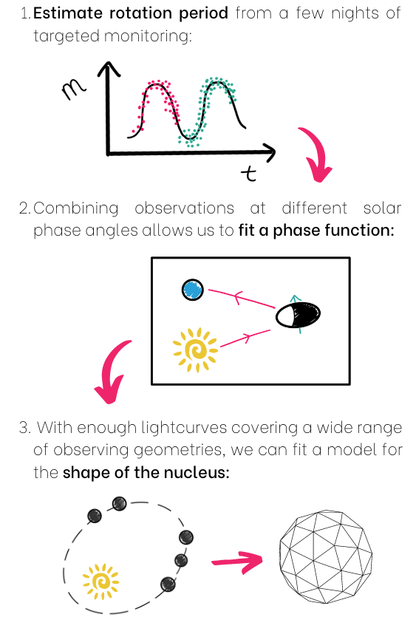
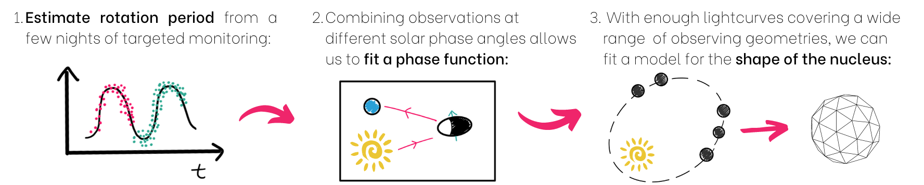
Uncovering the shapes of comets from the ground: The nucleus of comet 162P/Siding-Spring
Abbie Donaldson¹ Colin Snodgrass¹ Rosita Kokotanekova^{1,2,3} Agata Rożek¹
Motivation
Information on the shapes of comet nuclei has come primarily from a small number of situ missions (Figure 1) and one radar detection.
70% of seven short period comet nuclei show a bilobed morphology.
It is estimated that 20% of ~1000 radar-detected near-Earth asteroids could be contact binaries.
Is there a process specific to comets that results in the preferential formation of bilobed shapes? The sample size of comet nuclei with well-constrained shapes is currently too small to draw any conclusions.
What can we learn from nucleus photometry?
Phase function considerations
When using absolutely-calibrated lightcurves, it is necessary to fit a phase function as part of the shape modelling procedure.
Asteroids and other small solar system bodies show evidence for an opposition effect at phase angles ~0, but this phenomenon has not been detected from the ground for comet nuclei: a purely linear phase function is typically suitable for these dark objects at low solar phase (Figure 2).
Figure 2. Phase function fits to the rotationally-corrected 162P lightcurve points. The solid line shows the best-fitting linear fit; the dash line shows the best-fitting HG
Results for 162P/Siding Spring
162P is a large (R_{eff} ~ 7km), inactive JFC with a rotation period approximately 32.8h.
Extensive existing R-band lightcurve coverage between 2007 and 2018.
Geometric albedo 2.2% - one of the darkest surfaces of all studied comets [1].
Fitting shapes by convex lightcurve inversion
The shape of a small body has a larger effect on its rotational lightcurve than variations in light scattering properties across its surface [4,5]: we can therefore extract shape information from even sparse-in-time photometric data.
Convex lightcurve inversion (CLI) used to construct a convex “hull” of an object using lightcurve points collected over many epochs and a range of viewing geometries.
Technique is routinely used to model asteroid shapes [6,7,8], but only comet 67P/Churyumov-Gerasimenko (Rosetta mission target) has been modelled by this method to date.
Software package convexinv used here: For a given sidereal period and pole orientation, convexinv optimises convex shape and pole orientation that best fits the input lightcurves.
Figure 1. The six comets to have been imaged in situ. Image credits (top left to bottom right): 1P: Giotto/ESA 19P: NASA/JPL 9P: NASA/JPL/UMD 103P: NASA/JPL-CalTech/UMD 67P: ESA/Rosetta/MPS for OSIRIS Team MPS/UPD/LAM/IAA/SSO/INTA/UPM/DASP/IDA 81P: NASA
Aims of this work:
Combine new and existing lightcurves of Jupiter-family comet (JFC) 162P/Siding-Spring to create a convex model of its nucleus.
Explore to what extent convex lightcurve inversion can be used to expand the number of comets with well-constrained shape information.
Refine the method for fitting cometary phase functions using the resulting shape models to correct lightcurves for the rotation of the nucleus.
Comet property | Value
Rotation period | ~32.8 h
Geometric albedo | 0.022
Radius | 7 km
¹Institute for Astronomy, University of Edinburgh; ²European Southern Observatory, Garching; ³Institute of Astronomy and National Astronomical Observatory, Bulgarian Academy of Sciences
^{REFERENCES}

Slide 3
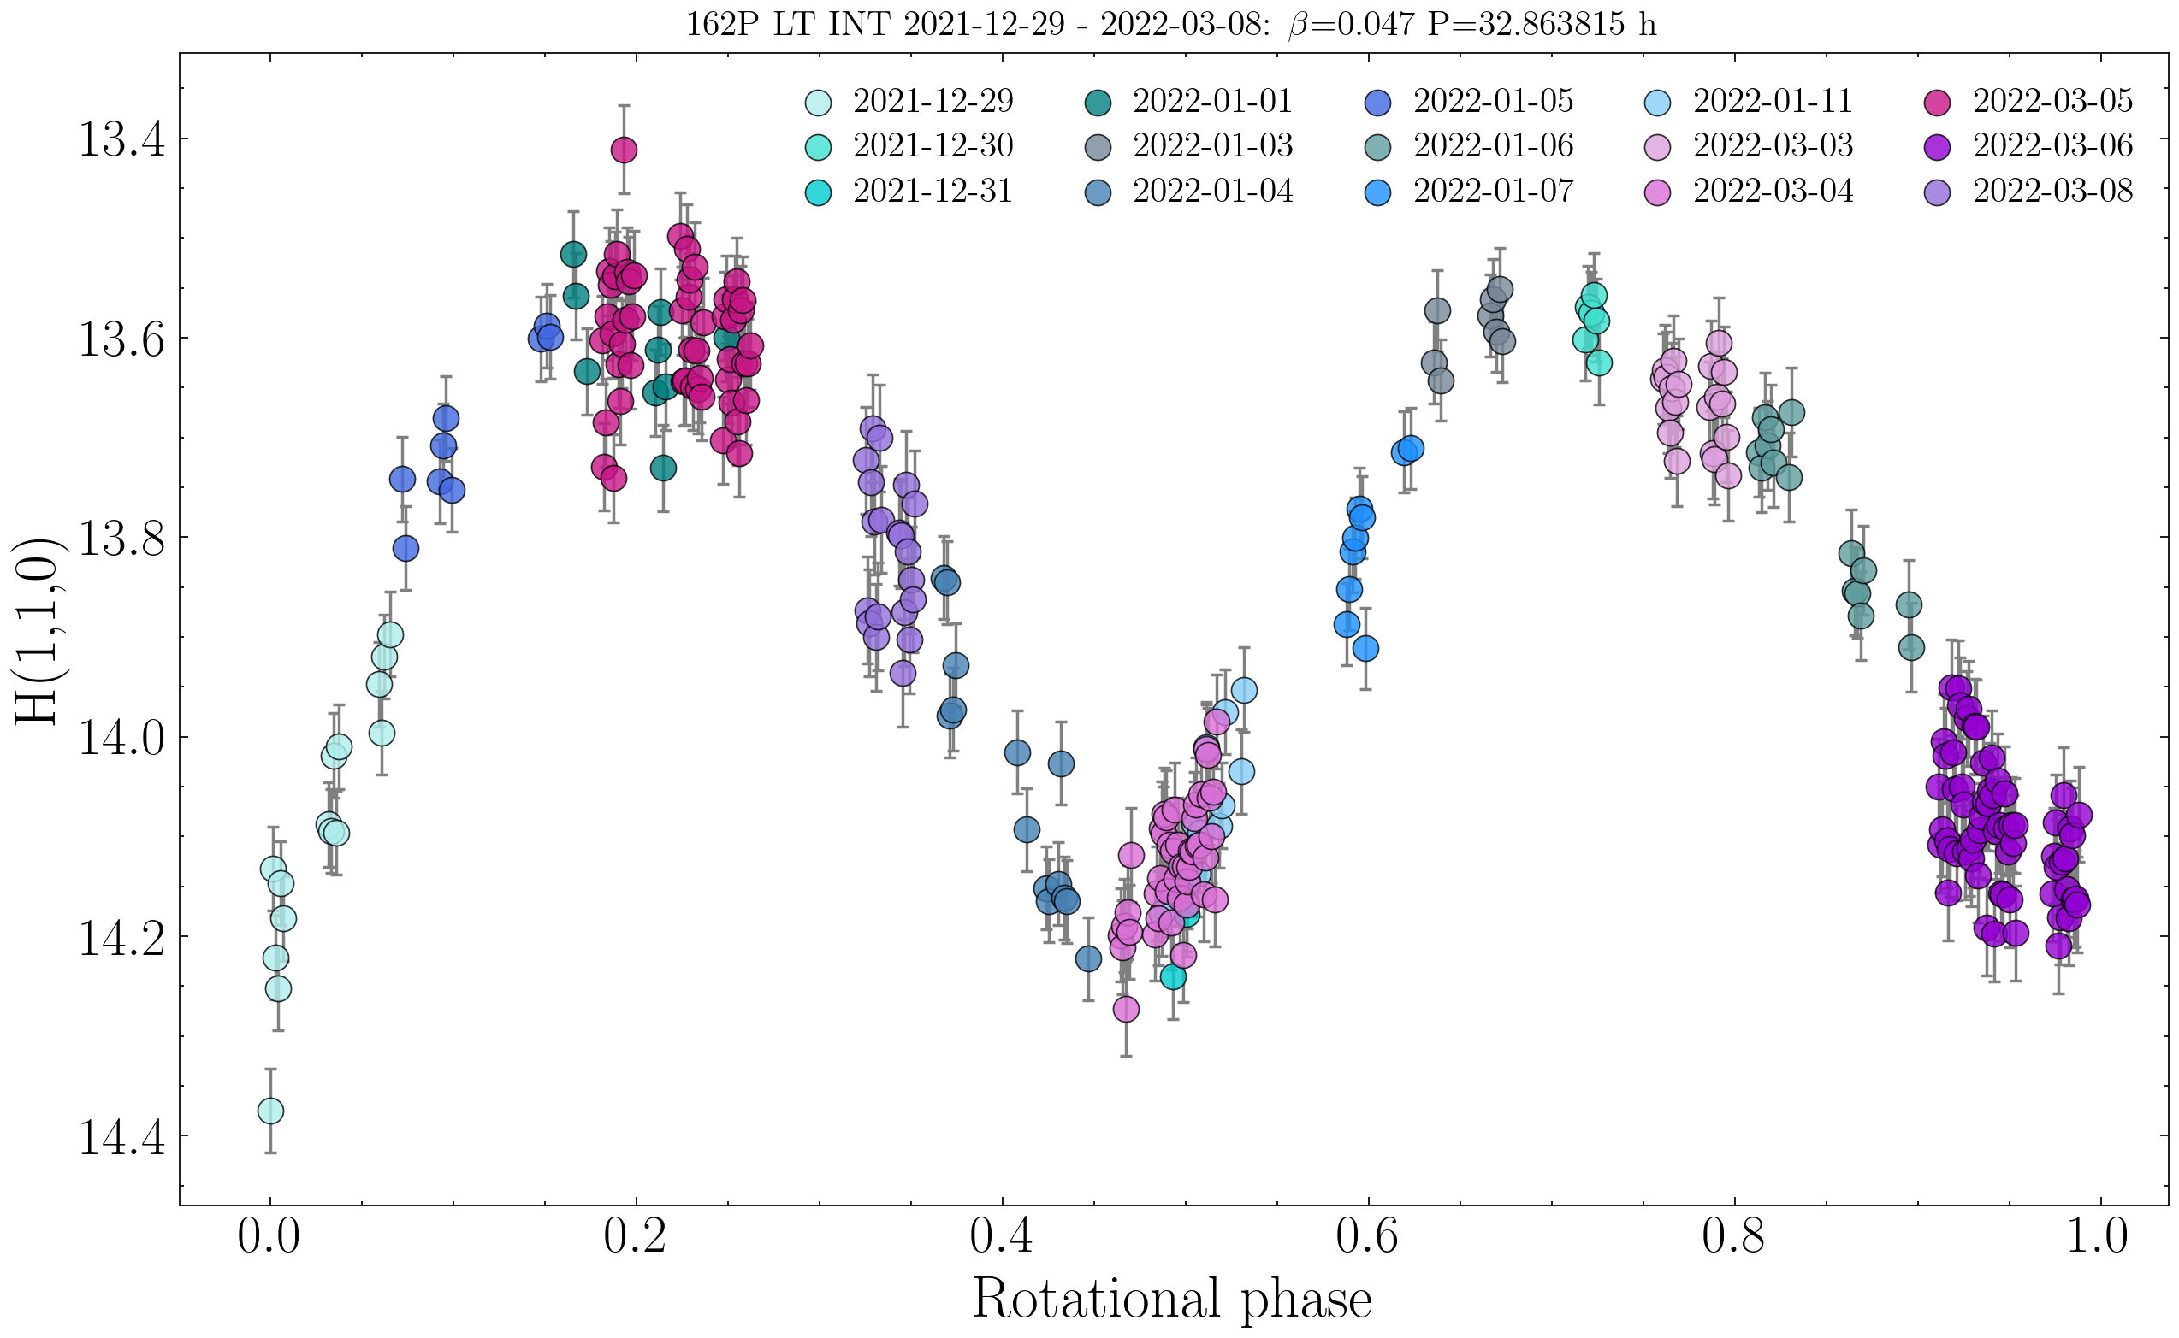
Uncovering the shapes of comets from the ground: The nucleus of comet 162P/Siding-Spring
Abbie Donaldson¹ Colin Snodgrass¹ Rosita Kokotanekova^{1,2,3} Agata Rożek¹
Motivation
Detailed information on the shapes of comets has come primarily from a small number of situ missions (Figure 1) and one radar detection. These types of studies are situational and extremely expensive/time-consuming.
These observations revealed that ~70% of seven short period comet nuclei have a bilobed shape. In comparison, it is estimated that only 20% of ~1000 near-Earth asteroids are in such contact binary configurations.
Is there a process specific to comets that results in the preferential formation of bilobed shapes? The present sample size of comet nuclei with well-constrained shapes is too small to answer this question.
Aim: Develop a method to identify the shapes of comet nuclei using solely ground-based observations.
What can we learn from nucleus photometry?
Application of CLI to 162P/Siding-Spring
We obtained new lightcurves of low-activity comet 162P in January & March 2022 (Figure 3). In total, we have collected 33 absolutely-calibrated PS1 lightcurves made up of ~1000 data points from 2007-2022.
We used convexinv to search for the best-fitting pole orientation and shape model, shown in Figures 4 and 5.
Figure 3.
Figure 4. X² distribution from a grid search for the direction of the model rotation pole over all ecliptic latitude (λ) and longitude (β).
Figure 5. Best-fit convex shape model of 162P with model z-axis aligned with spin axis.
Figure 2.
Discussion and scope for future work
The large, flat facets on the model can be interpreted as tentative evidence for a bilobed structure for 162P – CLI cannot replicate the concavities of this morphology, instead ‘covers’ them with flat regions.
Model dependent on chosen phase function: we can use the shape model to correct for the effects of rotation in the lightcurves and search for a cometary opposition effect by comparing shapes with different phase functions.
CLI is difficult to apply to comets: limited viewing geometries available from orbits largely confined to Ecliptic plane, and the nucleus can only reliably be observed when inactive.
Upcoming surveys such as LSST may provide increased coverage of viewing geometries, potential to streamline the shape modelling process for a greater number of comets and acquire a larger sample of nucleus shapes.
Modeling shapes from lightcurves
The lightcurve of a small body is highly dependent on its shape and aspect [1,2] meaning that shape information can be extracted from even sparse-in-time photometry.
Convex lightcurve inversion (CLI) constructs a convex “hull” of an object using lightcurves collected over multiple epochs and viewing geometries [3,4].
Software package convexinv [5] implements CLI to optimise a shape, sidereal period and pole orientation to best fit the input lightcurves.
Figure 1. The six comets to have been imaged in situ.
Image credits (top left to bottom right): 1P: Giotto/ESA 19P: NASA/JPL 9P: NASA/JPL/UMD 103P: NASA/JPL-CalTech/UMD 67P: ESA/Rosetta/MPS for OSIRIS Team MPS/UPD/LAM/IAA/SSO/INTA/UPM/DASP/IDA 81P: NASA
¹Institute for Astronomy, University of Edinburgh; ²European Southern Observatory, Garching; ³Institute of Astronomy and National Astronomical Observatory, Bulgarian Academy of Sciences
[1] Karttunen (1989) [2] Karttunen & Bowell (1989) [3] Kaasalainen & Torppa (2001)
[4] Kaasalainen et al. (2001) [5] Durech et al. (2010)

